Slide 1
Disclosure of Medical Error: Recommendations for Training Physician Assistants
Douglas Brock, PhD
Alicia Quella, PhD, MPAS, PA-C

Slide 2
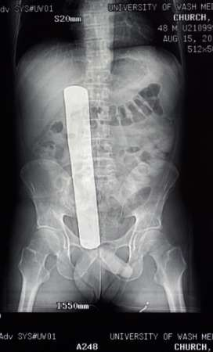
Nobody is perfect . . .

Slide 3
Objectives
Understand that error is common and difficult to reduce in healthcare settings.
Describe a training exercise to teach basic error disclosure skills.
Describe key disclosure communication elements to help ensure the patient’s needs are met.
Describe the “second victim” response to medical error.

Slide 4
Medical Error and Error Disclosure:
Small Actions and their Consequences
Case Example: Sepsis in the ED

Slide 5
Focus on Disclosure
Growing public awareness of medical error
New standards—National Quality Forum, Joint Commission and others
State laws on disclosure and apology
Evaluation of different disclosure approaches
Emphasis on transparency in healthcare

Slide 6
Medical Error: “To Err is Human”
  44,000–98,000 annual deaths from medical error
    8th leading cause of death in U.S.
    Cost: $8–29 billion annually
  1,000,000+ annual excess injuries
Kohn T, et. Al “To Err Is Human” 1999
Health Grades Quality Study 2004

Slide 7
Adverse Events and Medical Error Remain Common
2008 data from Agency for Health Care Research and Quality (AHRQ)
  Preventable adverse events on the rise – ~1% per year
2010 data from Medicare:
  13.5% of hospitalized beneficiaries experience an adverse event
  1.5% experienced harm that contributed to death
  44.0% were preventable adverse events or PAEs (errors)
Levinson D, et al. Adverse Events in Hospitals Among Medicare Beneficiaries. OIG for DHHS Nov, 2010

Slide 8
Medical Error: A New Look
  400,000+ annual deaths due to preventable adverse events or PAEs (error)
    40,000 to 80,000 diagnostic errors
  Serious harm 10-20 fold more common that death
    2 to 4 millions serious PAEs per year
James, JT, A new evidenced based estimate of patient harms associated with hospital care
Journal of Patient Safety, 2013

Slide 9
The Disclosure Gap
Harmful errors are common.
Reduction in the number of errors and reducing preventable adverse events has proven difficult.
Harmful errors are often not disclosed to patients.
When disclosure does take place, it often fails to meet patient expectations.

Slide 10
Closing the Disclosure Gap:
NQF’s Disclosure Safe Practice
Emphasizes transparency as a core value
Links disclosure with performance improvement
Articulates a process of disclosure
Details institutional disclosure support system
  Background education for healthcare workers
  Just-in-time coaching
  Emotional support for patients, families, providers

Slide 11
Rationale for Disclosing Errors to Patients
Extension of informed consent
Error disclosure as truth-telling
Regulatory requirements
  Joint Commission, hospital policy, state laws
Need to meet patient expectations
Possible reduction in legal liability

Slide 12
Responding to Error: The COPIC Experience

Slide 13
Quality of Actual Disclosures?
COPIC’s 3Rs: Disclosure and Compensation Program
2007-2009
  837 Events
  445 patient surveys
  705 physician surveys

Slide 14
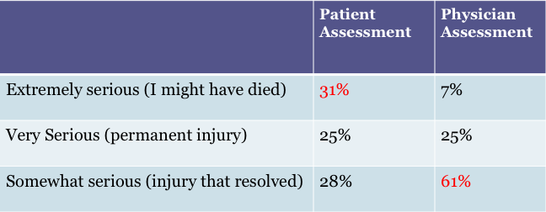
COPIC Experience

Slide 15
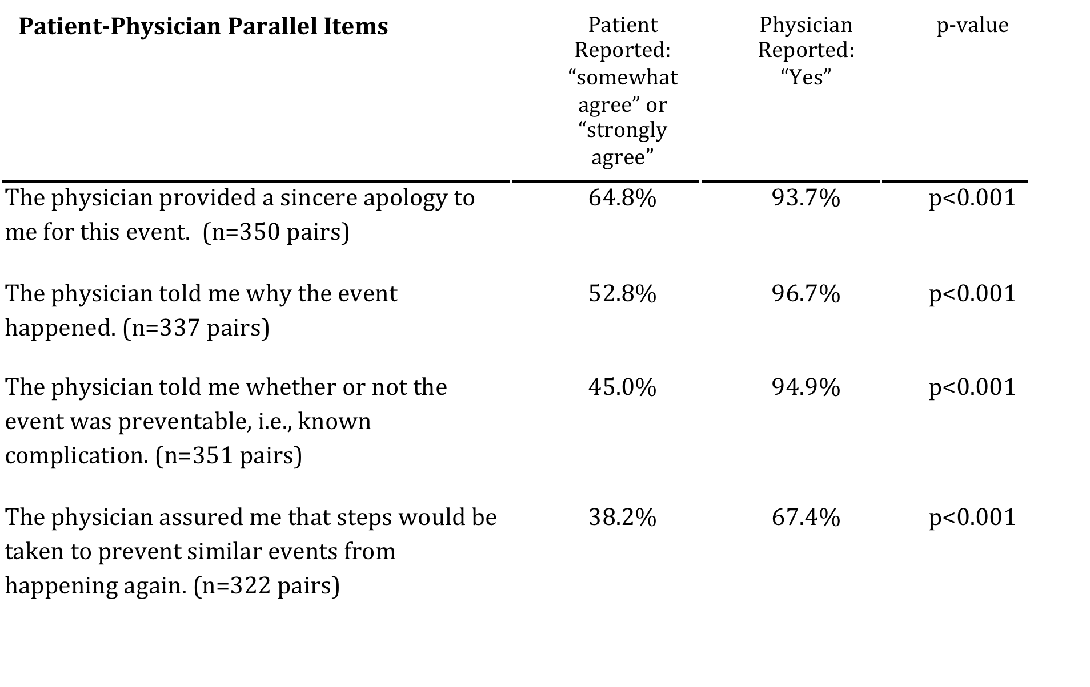
COPIC Experience

Slide 16
Overall Quality of the Disclosure

Slide 17
The Michigan Experience: An Emerging Approach
A departure from “deny and defend” which:
  Rejects fault for adverse events
  “Turfs” to attorneys, adversarial relationships develop
  Patient’s and physician’s needs become secondary
UMHS D&O emphasizes:
  Prompt response
  Open communication with patient and family
  Ensure patient views are heard and responded to
  Full investigation through internal UMHS committee
  Discourages physicians from disclosing error

Slide 18
The Michigan Experience: Results
Rate of new claims decreased from 7/100,000 to less than 5/100,000
Rate of lawsuits declined from 2.13/100,000 to 0.75/100,000
Median time from claim to resolution declined from 1.36 to 0.95 years
Improved culture of patient safety with steady improvement on biannual safety attitudes questionnaires

Slide 19
Physician Assistants and Medical Error
PAs will experience medical error in their careers.
PAs deliver healthcare in partnership with physicians, in a role described as, “negotiated performance autonomy.”
The roles that PAs and their supervising physicians play in the occurrence and disclosure of medical errors PAs is unknown.
Almost no research directly addresses PAs; instead focusing on physicians, nurses and pharmacists.

Slide 20
American Academy of Physician Assistants—AAPA
“A physician assistant should disclose to his or her supervising physician information about errors made in the course of caring for a patient. The supervising physician and PA should disclose the error to the patient if such information is significant to the patient’s interests and wellbeing. Errors do not always constitute improper, negligent, or unethical behavior, but failure to disclose them may.”
Guidelines for Ethical Conduct for the Physician Assistant Profession

Slide 21
Educating Physician Assistants
PA students and practitioners benefit from education in medical error and disclosure.
Educate supervisors (physicians) and preceptors (physicians, PAs, NPs, etc.) to model appropriate disclosure skills.
Provide opportunities to learn about and participate in the process of analysis of a medical error after it has occurred.
Seek opportunities for small group, especially interprofessional, discussions of medical error and disclosure.

Slide 22
Key elements for training PAs
Epidemiology of error
Institutional disclosure issues
Discussion and planning following an error
Disclosure conversations with a patient and their family
What to expect from patients
What to expect from colleagues and leadership
Personal reaction to error

Slide 23
A Recommended Training Model
Full training integrates:
  Didactic training
  Paired and small group role-play
    This benefits from being interprofessional (e.g., pharmacy, nursing, and medical students)
  Debriefing

Slide 24
Educating Physician Assistants
  Practice communicating through role play about a medical error in case scenarios
    Understand the importance of a timely expression of regret that is honest, personal, and empathetic
    Recognition of responsibility for the error and its harmful effects
    the importance of benevolent gestures or remedies for medical errors
    Patient and/or family expectations including the fear of abandonment
    Anticipation of potentially difficult to answer questions

Slide 25
Educating Physician Assistants
Provide participants with examples of appropriate expressions of regret:
  setting, body language, eye contact
  choice of terminology
Provide opportunities to practice in small groups.
Discuss and debrief as a large group afterword
Encourage peer feedback

Slide 26
Developing disclosure and apology skills: A proposal
A series of three one-on-one role plays allows:
  Practice in a simple acknowledgement of error outside of a clinical context
  Practice acknowledging a clinical error to a supervising clinician or other colleague
  Practice disclosing a clinical error to a patient
If time allows conduct an interprofessional “fish bowl” role play allowing:
  Multiple disciplines to disclose to a patient at the same time.

Slide 27
Getting the feel of it:
Select one member of a pair to be “the driver” and the second member of the pair to be the “car owner”.
When driver arrived and parked, you accidentally hit your neighbor’s car. The passenger door was dented slightly. The damage is about $500. No one was injured.
“Driver” discloses the accident to the “car owner”.

Slide 28
Disclosure to Supervising Physician
Provide a clinical case, where one participant is a physician and the other a physician assistant.
An error has occurred. Poor communication between a nurse and the physician assistant resulted in a fall occurring, no serious harm occurred, but the patient is frightened, and the result could have been worse.
Physician assistant disclosures error to physician.

Slide 29
Disclosure to the patient
Provide clinical case, where one participant is a physician assistant and the other a patient.
An error has occurred. Poor communication between a nurse and the physician assistant resulted in a fall occurring, no serious harm occurred, but the patient is frightened, and the result could have been worse.
Physician assistant discloses error to the patient.

Slide 30
Debrief of Group
Physician Assistant Role:
  How was it to disclose an error to your colleague?
Physician Role:
  What did you hear?
  What did you hope to hear?

Slide 31
Debrief of Group
Physician Assistant Role:
  How was it to disclose an error to a patient?
Patient Role:
  What did you hear?
  What did you hope to hear?

Slide 32
Some Questions to Stimulate Discussion
Should physicians ever disclose for a PA’s error?
Should PAs ever disclose for a physician’s error?
Should physicians and PAs disclose error as a team?
Should PAs disclose medical errors alone?

Slide 33
Disclosure: The basics

Slide 34
Discussion and Planning
A team needs to:
  understand institutional requirements for conduct of the disclosure.
  agree to who will be involved in the disclosure.
  agree to what will be said.
  agree to how each team member’s role will be represented.
  know what to expect from the patient and family.

Slide 35
The “Coaching” Model
Not realistic to train all clinicians in disclosure skills
Provide “Just in time” coaching to clinicians, 24x7
Train clinical leaders as disclosure coaches
  Facilitation and negotiation skills
  Knowledge of risk management and legal requirements
  Understanding the impact of adverse events on patients, families, and clinicians
  Knowledge of available support services

Slide 36
Disclosure and the Patient
Patients need:
  emotional support and acceptance.
  truthful information in a timely fashion.
  to understand that multiple discussions may be required to address all questions.
  medical information in appropriate, but jargon free language.
  to understand what happens next.
Providers need:
  Disclosure coaching
  Informational, instrumental and emotional support

Slide 37
Preparation: Advice for clinicians
Get help, prepare, and discuss as a team
  Most failed disclosures caused by lack of preparation
Attend to the patient’s medical needs
Initial discussion within a few hours of the event
Who will be in the room?
  Clinicians with prior relationship
  Ensure everyone is emotionally capable
  Careful planning of roles during discussion

Slide 38
What should be told?
Facts - generally the sooner the better
  But remember, the first story is usually incomplete and sometimes even wrong
Avoid natural desire to “put it all together”

Slide 39
Steps in Disclosing Error: A Process
Explain that an error occurred
Apologize and express regret for the error
Convey the underlying elements resulting in the error
Address medical ramifications and how the error will be managed
Describe steps that will be taken to prevent the recurrence of the error
Arrange to speak again at a time that is convenient to patient and family
Talk about follow-up

Slide 40
Be Prepared for Compensation Questions
Acknowledge that the question is legitimate.
Explain that you are not qualified or authorized to address those issues.
Assure them that others who are qualified will speak with them in the near future.

Slide 41
Emotion Handling
Anger
Sadness
Fear
Uncertainly

Slide 42
Understanding the Apology
“I’m sorry for what has happened to you.”
  Always appropriate
Do not blame “the system” or colleagues.
  “Hospitals are complicated places….”
  “I’m sorry, if the nurse had only called me…”
Be careful of apologies that include “buts.”
  “I know this is unpleasant, awful, …. but believe me, for me its shattering.”

Slide 43
What Comes Next?
  Patient and patient’s family’s response
    Disclosure skills are key
  Legal or institutional retaliation
    Working with your institution
    Malpractice concerns
  Professional concerns
    Colleagues will lose trust
    Patients will lose trust
  Become an advocate

Slide 44
“Second Victim”
Controversial term
Reaction has been liked to an acute stress disorder
  Embarrassment
  Denial and detachment
  Loss of confidence
  Inappropriately adjusting practice
  Emotional and physical health
    Depression
    Anxiety
    Re-experiencing the event
    Substance abuse

Slide 45
“Second Victim”
Seek support, take time to heal
  Risk managers and critical incident teams
  Support groups
  Your physician supervisor
  Your PA colleagues
  Other healthcare provider colleagues
  Personal counseling
Become an advocate for others

Slide 46
Resources
HealthPact
  http://www.healthpact.org
Center for Health Sciences Interprofessional Education, Research and Practice
  http://collaborate.uw.edu/

