Slide 1








P.A.S.S.
PA Student Success:
PAs Transforming Healthcare
PA Education Association

Slide 2




What is a PA?
Physician Assistants/Associates (PA)
Practice medicine in EVERY specialty in ALL clinical settings.
Are skilled members of the health care team.
Perform routine medical services and intricate procedures.
Notes:
PAs also fulfill a board range of medical services otherwise provided by the physician.

Slide 3


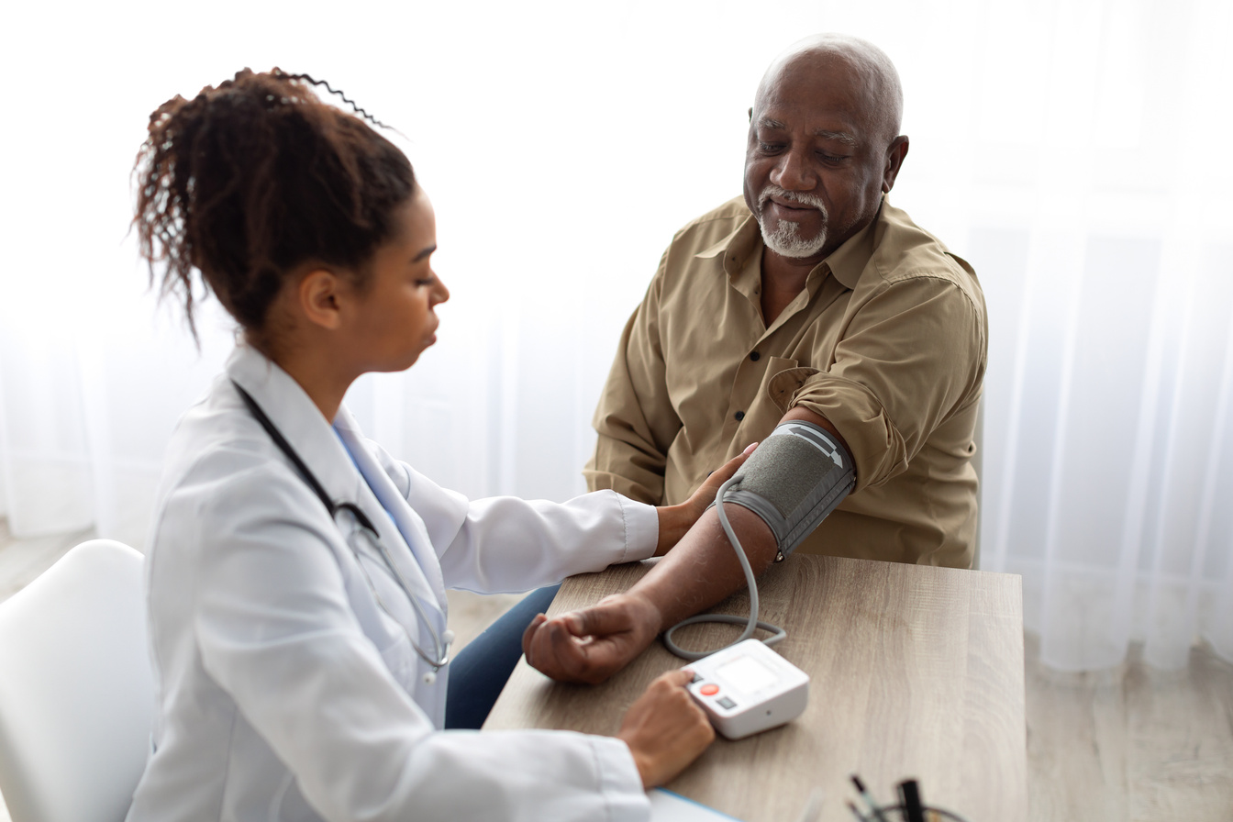
What do PAs do?
PA Works | PA Works | PA Works
They conduct physical exams | They order AND interpret medical tests | They assist in surgery
They diagnose and treat illnesses | They counsel on preventive healthcare | They perform procedures
They write prescriptions | They educate patients and their families | They do rounds in hospitals

Slide 4

A look through PA history
Physicians at Duke University Medical School recongized a need.
Former military corpsmen sought an opportunity to use medical skills in civilian life.
The first 3 PAs graduated from Duke University.
Opens the doors for others to study PA education.
1960s
1965
1967
1970s
Notes:
In the mid-1960s, physicians at Duke University Medical School recognized the need for a new type of health professional with comprehensive medical education to increase access to quality health care.
In 1965, the first PA students were former military corpsmen seeking an opportunity to use their medical skills in civilian life.

Slide 5


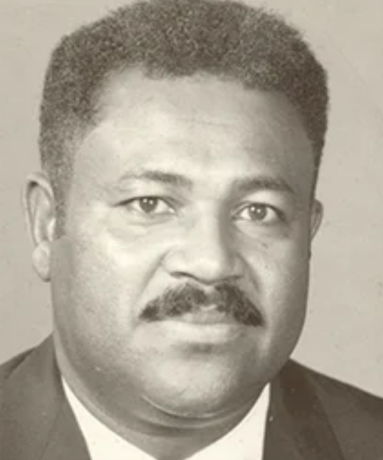
Henry Lee “Buddy” Treadwell
Precursor to physician assistant.
Earned honorary PA certificate in 1970.
Veteran and leader in his community.
Eugene Stead modeled the PA profession largely on the interactions noted between Treadwell and his supervising MD.

Slide 6

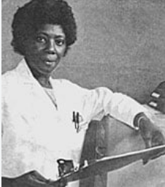
Joyce Nichols, PA-C
First woman formally educated as a PA
First Black woman to practice as a PA.
Served on AAPA Board of Directors.
Established the AAPA Minority Affairs Committee.
Established one of the first rural health satellite clinics.

Slide 7


What’s being said...
Will grow 27% much faster
than the average
9% growth rate
#2 in
Best Health
Care Jobs
Great careers
for YOUR
future!
#4 in
Best Jobs
Ranking
Notes:
U.S. News & World Report ranked the PA profession #2 in its 2022 Best Health Care Jobs and #4 in its 100 Best Jobs ranking.
Kiplinger’s named PA as one of its “great careers for your future.”
The PA profession has grown 76% over the last decade.​

Slide 8
What’s being said...
$126,010
is the MEDIAN
annual salary of PAs
#5 fastest growing
jobs in America
5 out of 10
Work-life balance
score
9 out of 10
Job market score
Notes:
U.S. News & World Report ranked the PA profession #2 in its 2022 Best Health Care Jobs and #4 in its 100 Best Jobs ranking.
Kiplinger’s named PA as one of its “great careers for your future.”
The PA profession has grown 76% over the last decade.​

Slide 9
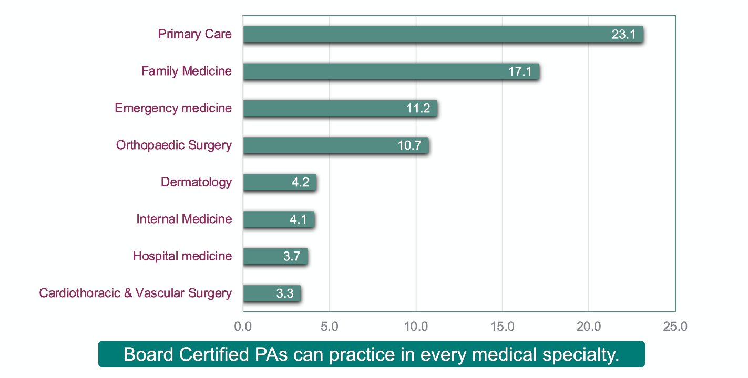
Top 7 PA Practice Specialties

Slide 10
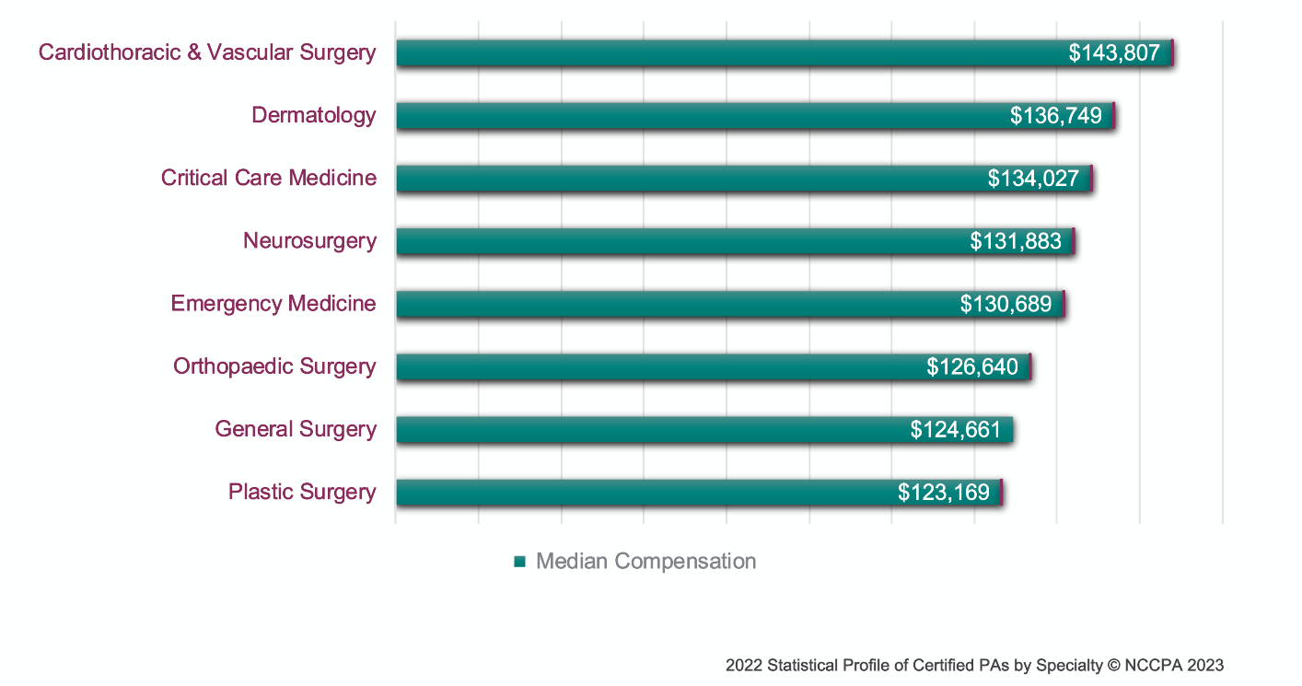
PA Income by Specialty

Slide 11
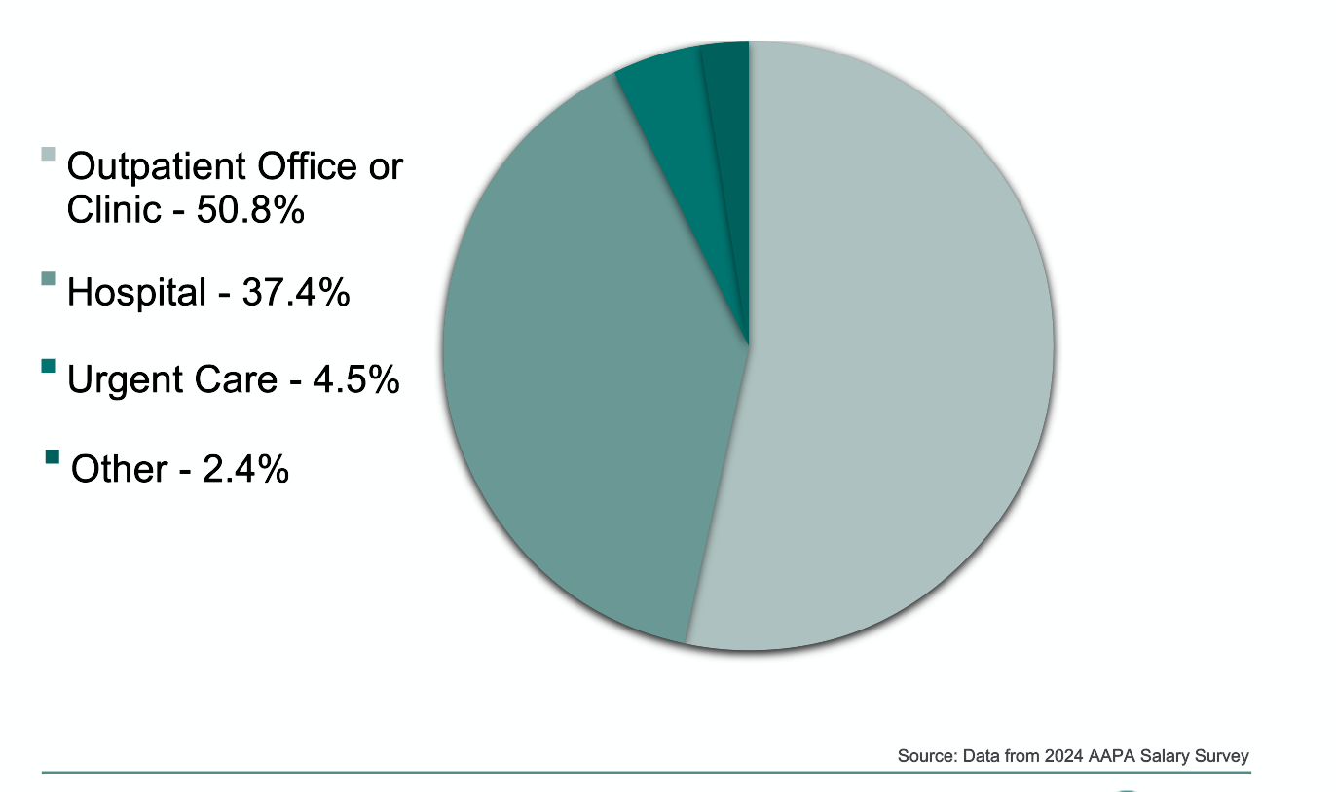
Top PA Practice Settings

Slide 12

Undergraduate Ed.
Preparing for PA School
Select an appropriate major for your Bachelor’s Degree.
Biology, Health Science, & Psychology, etc.
Research PA programs to determine what prerequisites are required
Maintain a high GPA, especially in science courses.
Determine if any standardized test(s) will be required.
Get health/patient care experience.
PA Programs ARE graduate programs.

Slide 13

Additional Resources:
PA Program Directory:
https://paeaonline.org/our-programs
PAEA Website:
https://paeaonline.org/how-we-can-help/advisors

Slide 14
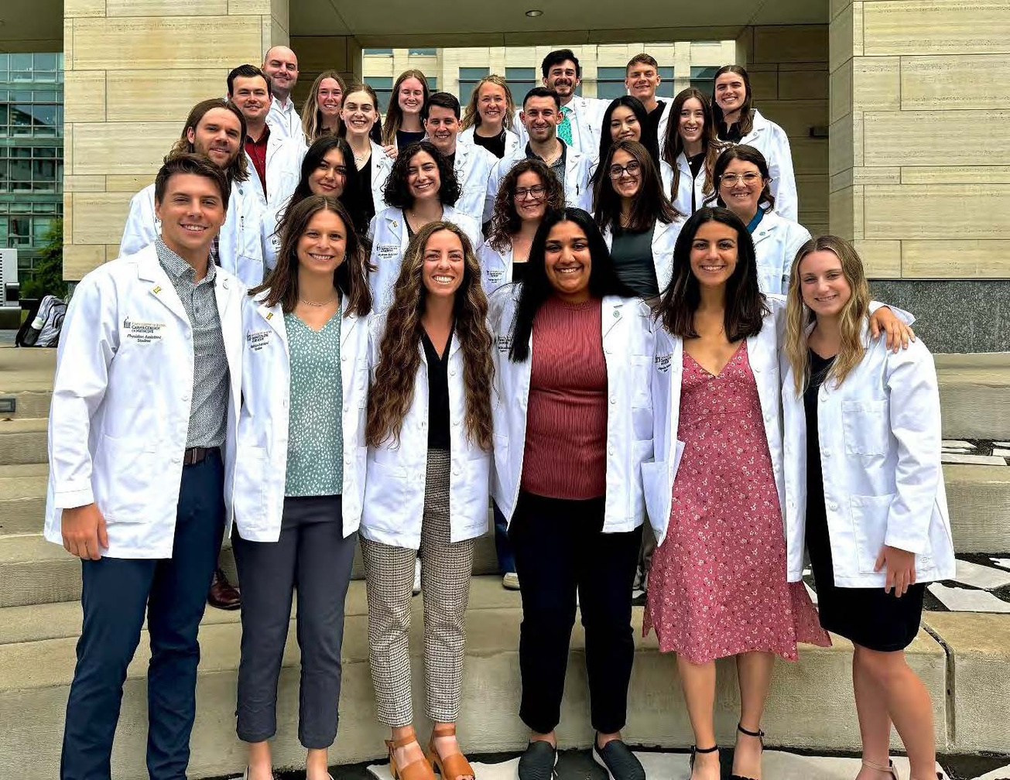
Preparing for PA School
MOST programs REQUIRE the following coursework:
Physiology
Anatomy
Biological Sciences
Chemistry
College Math
Computer Science
English

Slide 15
Tips for educational success
Read before class
Ask questions in class
Take organized notes
Attend class regularly
Use planners & prioritize
Study in 1-hour blocks
Don’t cram for tests
Find a mentor
Test yourself
Sleep before exams!
Breathe & relax during exams
Use time management
Ask the teacher(s) for study tips

Slide 16



Paying for PA School
1
National Health Services Corps- A federal program for PAs who practice primary care in underserved communities.
2
The U.S. Department of Veterans Affairs - Offers the health professional scholarship program to students receiving education/training in healthcare services

Slide 17
Paying for PA School
3
AmeriCorps - helps pay for education loans in exchange for a year of service in designated areas across the U.S.
4
Indian Health Service (IHS): a national loan repayment program with the goal of placing health care professionals, including PAs, in IHS health centers for a minimum of 2 years.

Slide 18
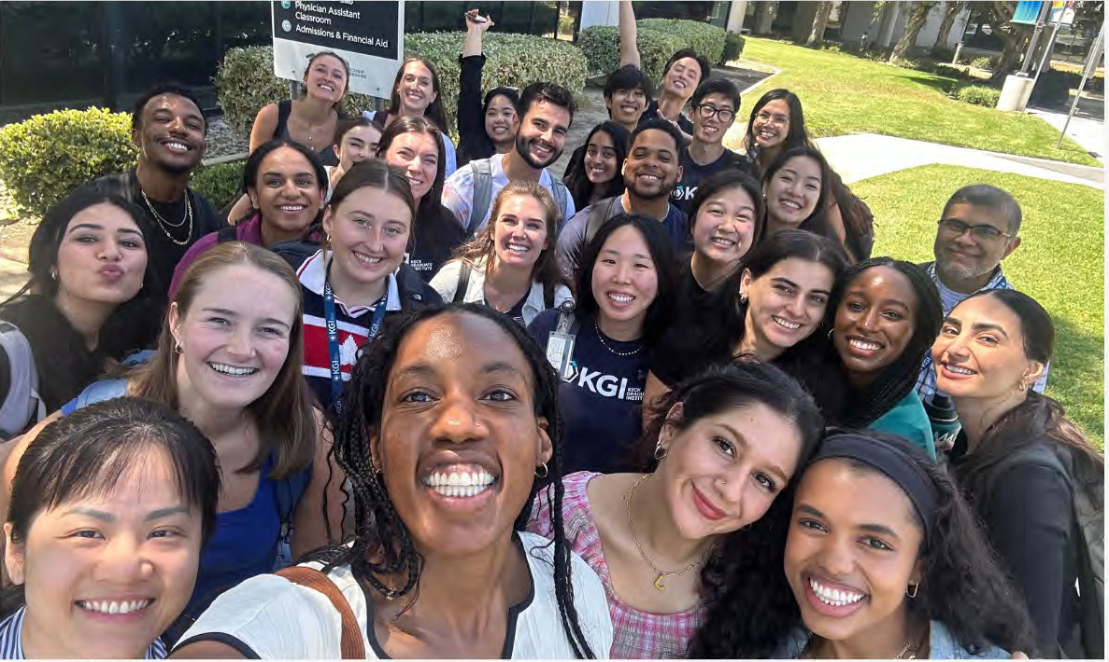

Being able
to practice
medicine
Growth in
scope of practice
over time
Contributions to
PA Job Satisfaction
Work/life
work balance
Ability to change
specialties/
work settings
easily
Notes:
According to the 2017, AAPA Salary Survey, when asked, 82% of respondents said that they would become PAs all over again.

Slide 19






Evaluation
Student Survey
Facilitator Survey

Slide 20


Questions?

Slide 21






Get more information:
Ask your questions: students@PAEAonline.org
Visit the PAEA Program Directory: www.PAEAonline.org/our-programs
Pre-PA & Advisor Webpage: www.PAEAonline.org/how-we-can-help/advisors

